Slide 1
Computer Programming Basics
Jeon, Seokhee
Assistant Professor
Department of Computer Engineering,
Kyung Hee University, Korea

Slide 2
About The Lecture Note
This lecture note is intended to be used by students in “Computer Programming Basics” course at the Kyung Hee University.
Large portion of the materials is based on the lecture note supplied by the authors of the textbook “Computer Science : A Structured Approach Using C++, 2nd Edition.”

Slide 3
LECTURE 1

Slide 4
What is computers?
Wikipedia says
  “A computer is a general purpose device that can be programmed to carry out a finite set of arithmetic or logical operations.”
Device? Hardware!
Programmed? Software!
Arithmetic or logical? Digital!

Slide 5


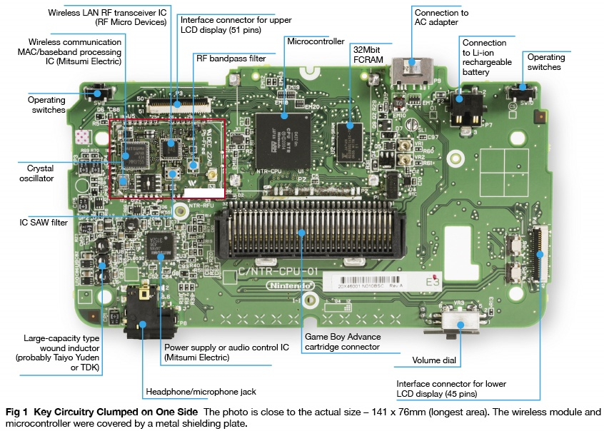




Nintendo DS
Hardware
Software

Slide 6
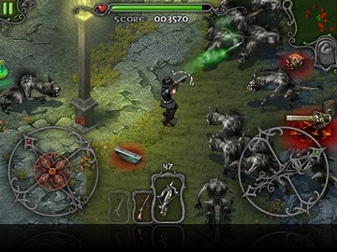

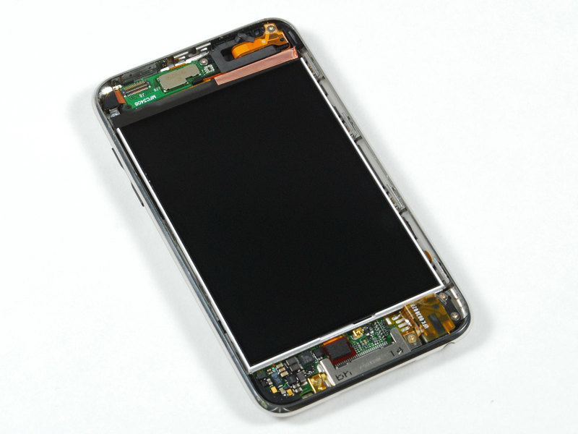

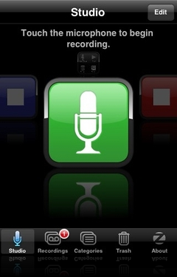
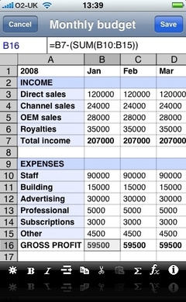
Apple iPod/iPhone
Hardware
Software

Slide 7



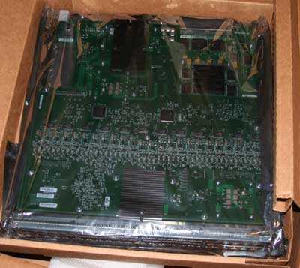



Internet
Hardware
Software

Slide 8
Computer Programming

Slide 9
Program and Programming
Computer program ≅ Software
Computer programming ≅ “Making software”
Computer programmer = A person who develops software

Slide 10
Computer Programming Language

Slide 11
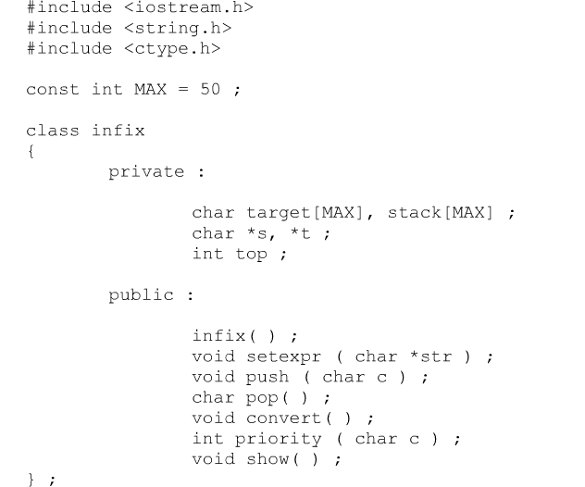
Programming Language
A programming language is an artificial language designed to communicate instructions to a machine, particularly a computer.

Slide 12
Programming Language
Human Language | Programming Language
Naturally created, e.g., Chinese, Korean, English,… | Artificially developed, e.g., C, Basic, C#, Fortran,…
Interpreted mostly by human | Interpreted by human and computer
Ambiguities and exceptions in syntax and grammar | Clear and precise syntax

Slide 13
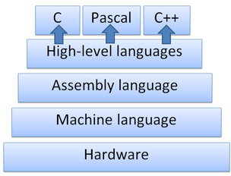
Hierarchy of Programming Language

Slide 14
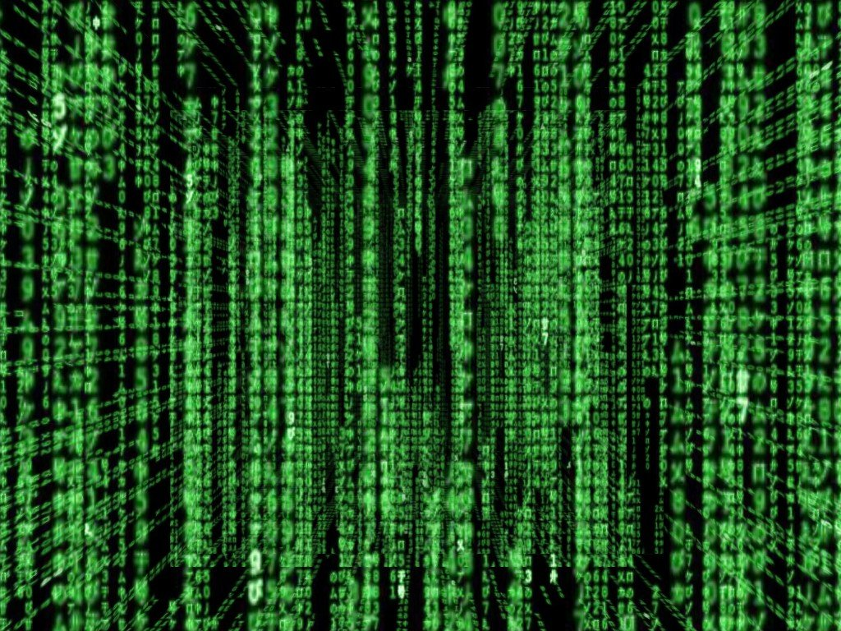

Hierarchy of Programming Language
The movie “Matrix”
Can’t you see? Neo is here.

Slide 15
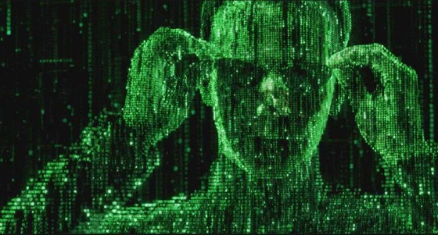
Hierarchy of Programming Language
The movie “Matrix”
Now you can pick Neo, but not clearly.

Slide 16
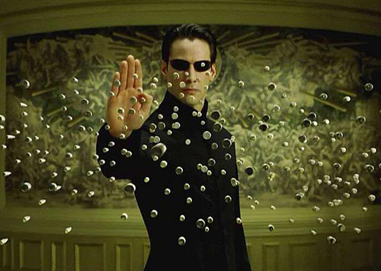
Hierarchy of Programming Language
The movie “Matrix”

Slide 17
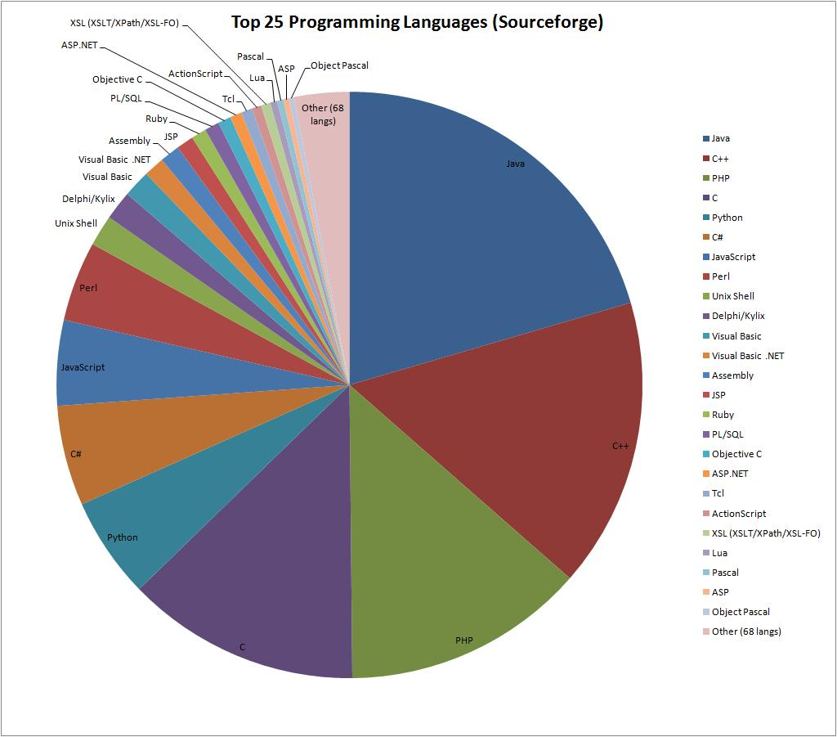

Slide 18
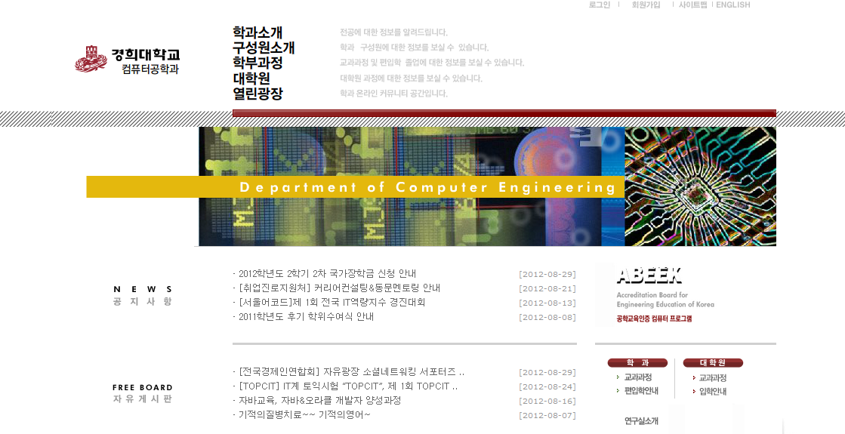
Examples of Programming Language
- HTML (Hyper Text Markup Language)
<html>
<head>
<meta http-equiv="content-type" content="text/html; charset=euc-kr">
<title>▒경희대학교 전자정보대학▒</title>
</head>
<frameset rows="1*" cols="100%" border="0">
<frame name="electronic" scrolling="auto" marginwidth="0" marginheight="0" src="electronic/main.php">
<noframes>
<body bgcolor="#FFFFFF" text="#000000" link="#0000FF" vlink="#800080" alink="#FF0000">
<p>&nbsp;</p>
</body>
</noframes>
</frameset>
</html>

Slide 19
Examples of Programming Language
- FORTRAN (Numeric Computation & Scientific Computing)
DIMENSION X(32), Y(32), B(34)
C
C GENERATE RANDOM NUMBERS AND STORE ARRAY IN B SO
C THE SAME SEQUENCE CAN BE USED IN ALL TESTS.
C NOTE THAT B IS DIMENSIONED TO SIZE N+2.
C
C IW IS A MACHINE DEPENDENT WRITE DEVICE NUMBER
C
IW = I1MACH(2)
C
DO 10 I=1,32
X(I) = UNI(0)
B(I) = X(I)
10 CONTINUE
M = 5
N = 2**M
NP1 = N + 1
NP2 = N + 2
KNT = 1
C
C TEST FAST-FSST THEN FFA-FFS
C
WRITE (IW,9999)
20 WRITE (IW,9998) (B(I),I=1,N)
IF (KNT.EQ.1) CALL FAST(B, N)
IF (KNT.EQ.2) CALL FFA(B, N)
WRITE (IW,9997) (B(I),I=1,NP1,2)
WRITE (IW,9996) (B(I),I=2,NP2,2)
IF (KNT.EQ.1) CALL FSST(B, N)
IF (KNT.EQ.2) CALL FFS(B, N)
WRITE (IW,9995) (B(I),I=1,N)
KNT = KNT + 1
IF (KNT.EQ.3) GO TO 40
C
WRITE (IW,9994)
DO 30 I=1,N
B(I) = X(I)
30 CONTINUE
GO TO 20

Slide 20
Examples of Programming Language
- COBOL (COmmon Business-Oriented Language)
$ SET SOURCEFORMAT"FREE"
IDENTIFICATION DIVISION.
PROGRAM-ID. Multiplier.
AUTHOR. Michael Coughlan.
* Example program using ACCEPT, DISPLAY and MULTIPLY to
* get two single digit numbers from the user and multiply them together
DATA DIVISION.
WORKING-STORAGE SECTION.
01 Num1 PIC 9 VALUE ZEROS.
01 Num2 PIC 9 VALUE ZEROS.
01 Result PIC 99 VALUE ZEROS.
PROCEDURE DIVISION.
DISPLAY "Enter first number (1 digit) : " WITH NO ADVANCING.
ACCEPT Num1.
DISPLAY "Enter second number (1 digit) : " WITH NO ADVANCING.
ACCEPT Num2.
MULTIPLY Num1 BY Num2 GIVING Result.
DISPLAY "Result is = ", Result.
STOP RUN.

Slide 21
Examples of Programming Language
- PASCAL (General/Education Purpose)
var NodeFile,LinkFile: Text;
NetRoot,NodeList: NetNodePtr;
EvidenceVector: NetVector;
{ ******************** Math Support ******************** }
procedure Normalize(var Vector: NetVector);
{ Scales incoming Vector so that it sums to unity }
var i: ValueRange;
Sum: real;
begin
Sum := 0;
with Vector do
begin
for i := 1 to NVals do
Sum := Sum + Data[i];
for i := 1 to NVals do
Data[i] := Data[i] / Sum
end
end;
procedure MakeIdentityVector(var Vector: NetVector;Length: ValueRange);
{ Makes incoming Vector into an identity vector of specified length}
var i: ValueRange;
begin
with Vector do
begin
NVals := Length;
for i := 1 to Length do
Data[i] := 1.0
end
end;

Slide 22
Examples of Programming Language
- PROLOG (For Artificial Intelligence)
turing(Tape0, Tape) :-
perform(q0, [], Ls, Tape0, Rs),
reverse(Ls, Ls1),
append(Ls1, Rs, Tape).
perform(qf, Ls, Ls, Rs, Rs) :- !.
perform(Q0, Ls0, Ls, Rs0, Rs) :-
symbol(Rs0, Sym, RsRest),
once(rule(Q0, Sym, Q1, NewSym, Action)),
action(Action, Ls0, Ls1, [NewSym|RsRest], Rs1),
perform(Q1, Ls1, Ls, Rs1, Rs).
symbol([], b, []).
symbol([Sym|Rs], Sym, Rs).
action(left, Ls0, Ls, Rs0, Rs) :- left(Ls0, Ls, Rs0, Rs).
action(stay, Ls, Ls, Rs, Rs).
action(right, Ls0, [Sym|Ls0], [Sym|Rs], Rs).
left([], [], Rs0, [b|Rs0]).
left([L|Ls], Ls, Rs, [L|Rs]).

Slide 23
C++

Slide 24
Why C++?
Popularity
Huge numbers of users to ask questions
Open source codes, tutorials, and libraries all over the internet

Slide 25
Why C++?
Flexibility
C++
high level programming features,
e.g., object-oriented, function
+
low level hardware management functionalities,
e.g., memory management, bitwise operation

Slide 26
Why C++?
Wide coverage
C++
Structured
Programming
Object-Oriented
Programming
C
JAVA
Low-Level
Programming
Friendly
High-Level
Programming
Friendly

Slide 27
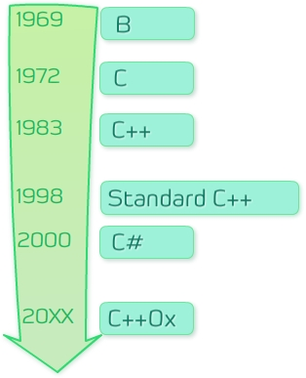
Brief History of C++
11

Slide 28
Review
Computer: Hardware and software
Software is important
Programming = Software developing
Programming language: artificial language specially designed for software development
Machine – assembly – high-level languages
C++ is awesome!

